Slide 1

Malakai, our cat

Slide 2
JOKES
Disclaimer: Some content on the following slides may cause you to sigh.

Slide 3
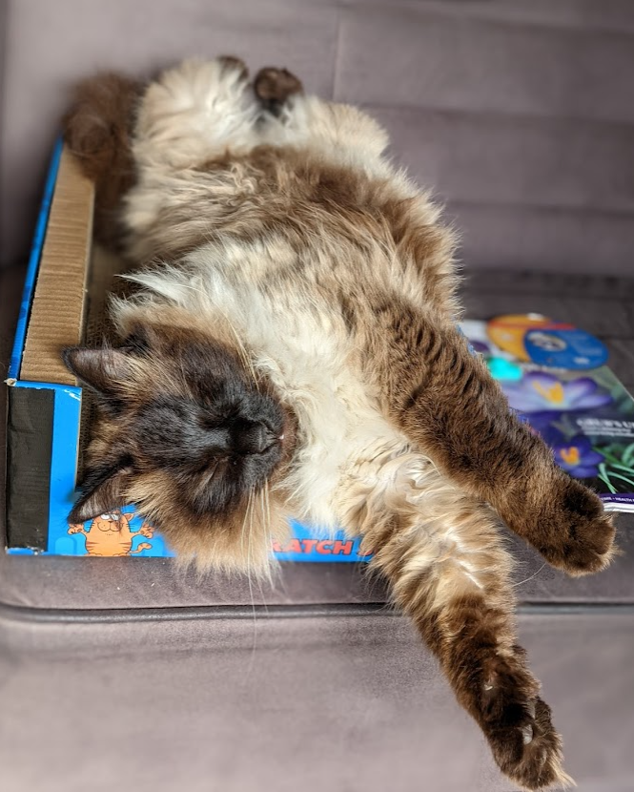
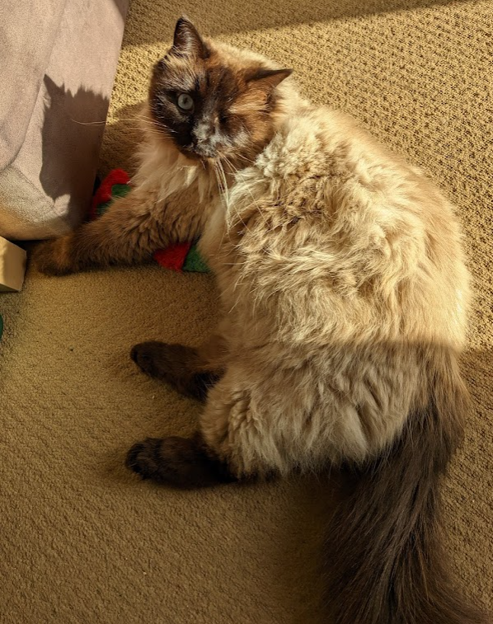

Slide 4
Two TV aerials fell in love and decided to get married.
The wedding, as you can imagine, was very dull
But the reception
was

Slide 5
FANTASTIC

Slide 6
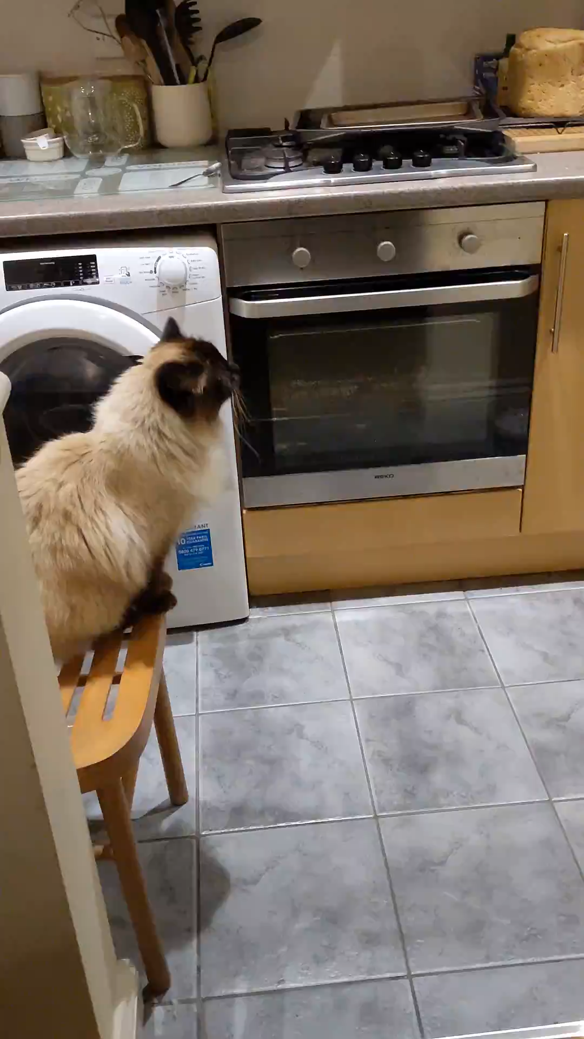
NOT a quiet cat
NOT a quiet cat
NOT a quiet cat
NOT a quiet cat
NOT a quiet cat

Slide 7
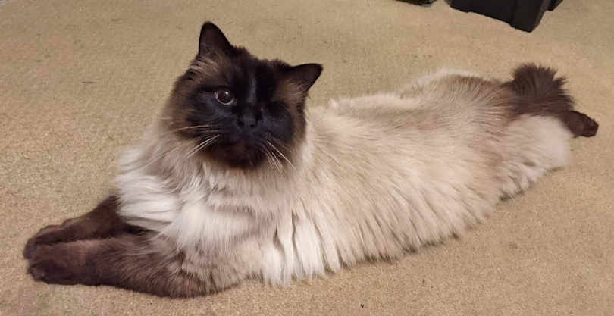


Slide 8
At camouflage training my commanding officer told me he didn’t see me there.
I said thanks!

Slide 9
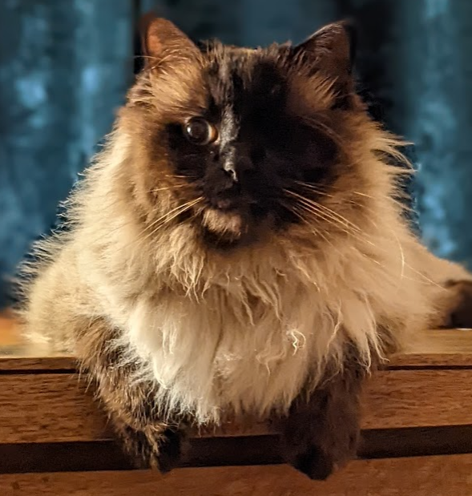

Slide 10
To the thief that stole my anxiety drugs and my wheelchair
I hope you’re happy.
You can hide but you can’t run!

Slide 11
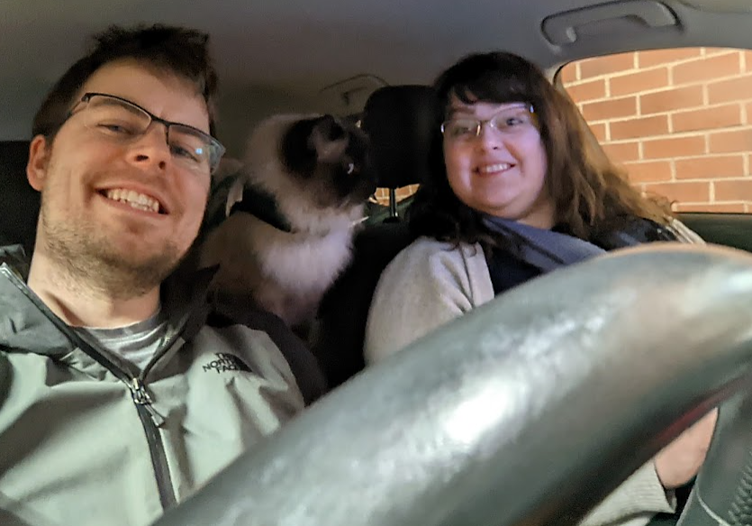

Slide 12
Today a man knocked on my door and asked for a small donation towards the local swimming pool.
So I gave him a glass of water

Slide 13
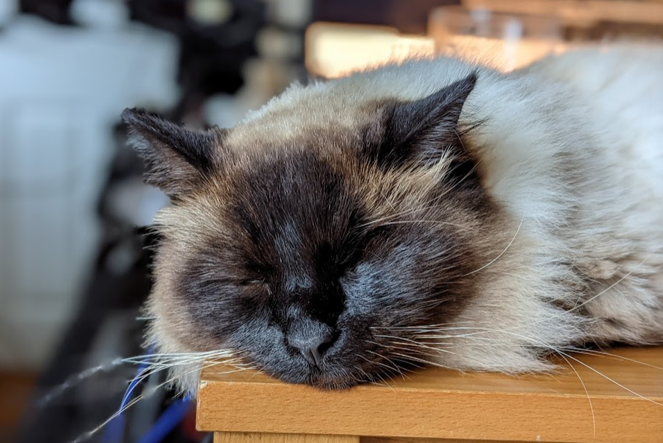

Slide 14
Why can’t you use Beef as your password?
Because it’s not stroganoff!

Slide 15
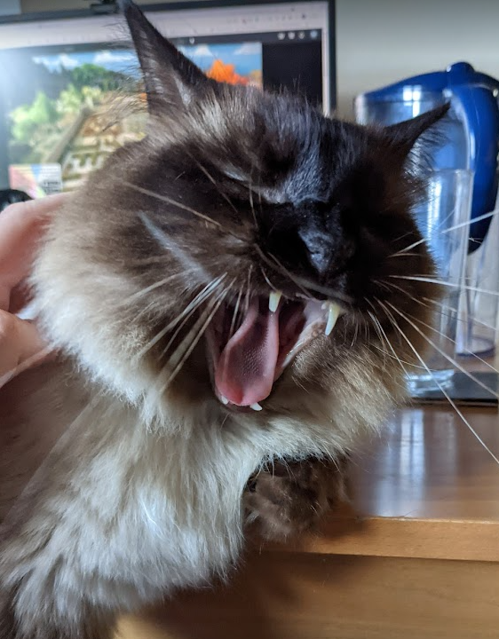

Slide 16
I lost my job at the calendar factory
All I did was take a week off!

Slide 17
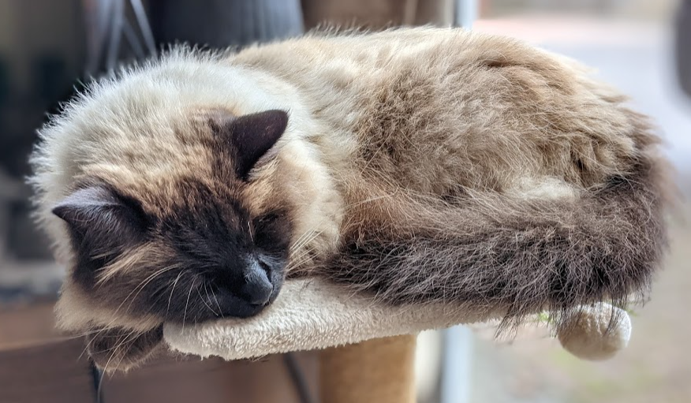

Slide 18
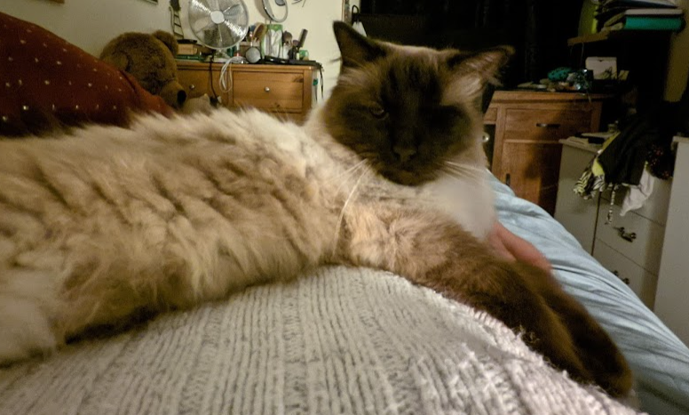

Slide 19
Any questions?
Positive feedback is more than welcome
Negative feedback is also welcomed. Please put any concerns into writing and place it in your recycling bin

